Slide 1
PROBLEM ID: GH-183. TEAM ID: 817. PROBLEM STATEMENT: GPS BASED VEHICLE TRACKING SYSTEM FOR SCHOOL CHILDREN.
TEAM LEADER: JIGNESH DESAI.
GOVERNMENT POLYTECHNIC, AHMEDABAD.

Slide 2
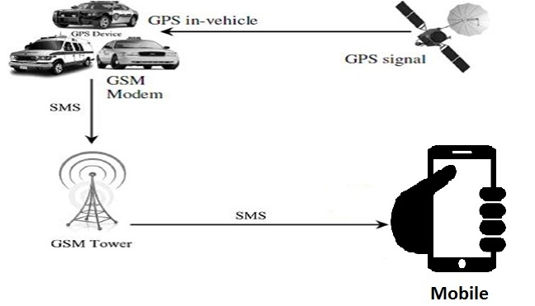
FLOW DIAGRAM

Slide 3
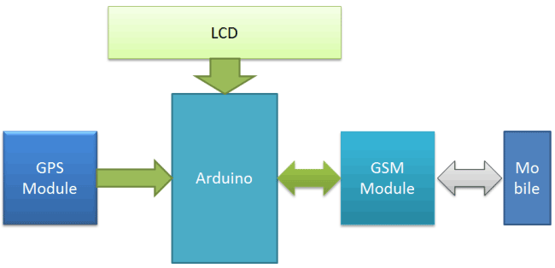
BLOCK DIAGRAM

Slide 4
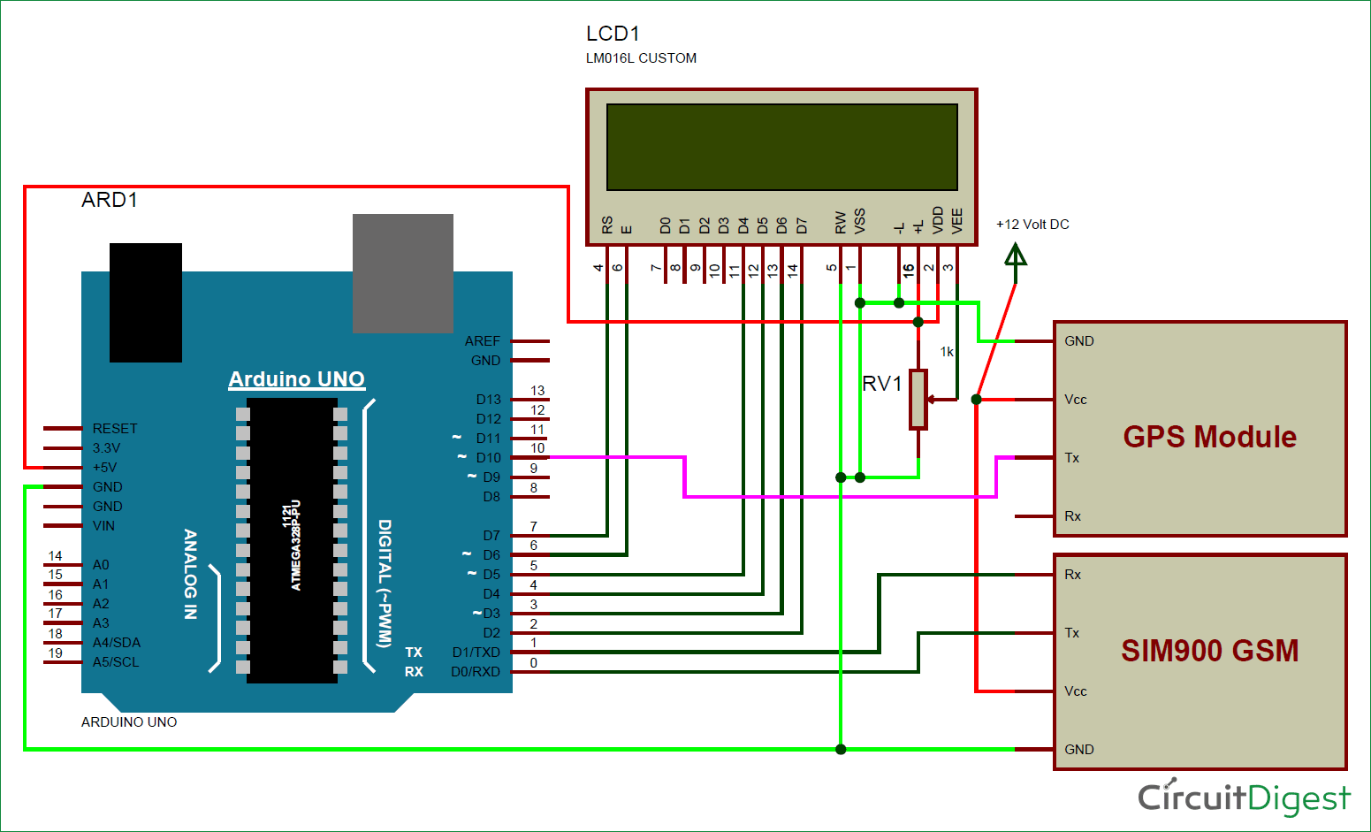
CIRCUIT DIAGRAM

Slide 5
COMPONENT REQUIRED
Arduino
GSM Module
GPS Module
16x2 LCD
Power Supply
Connecting Wires
10 K POT

Slide 6
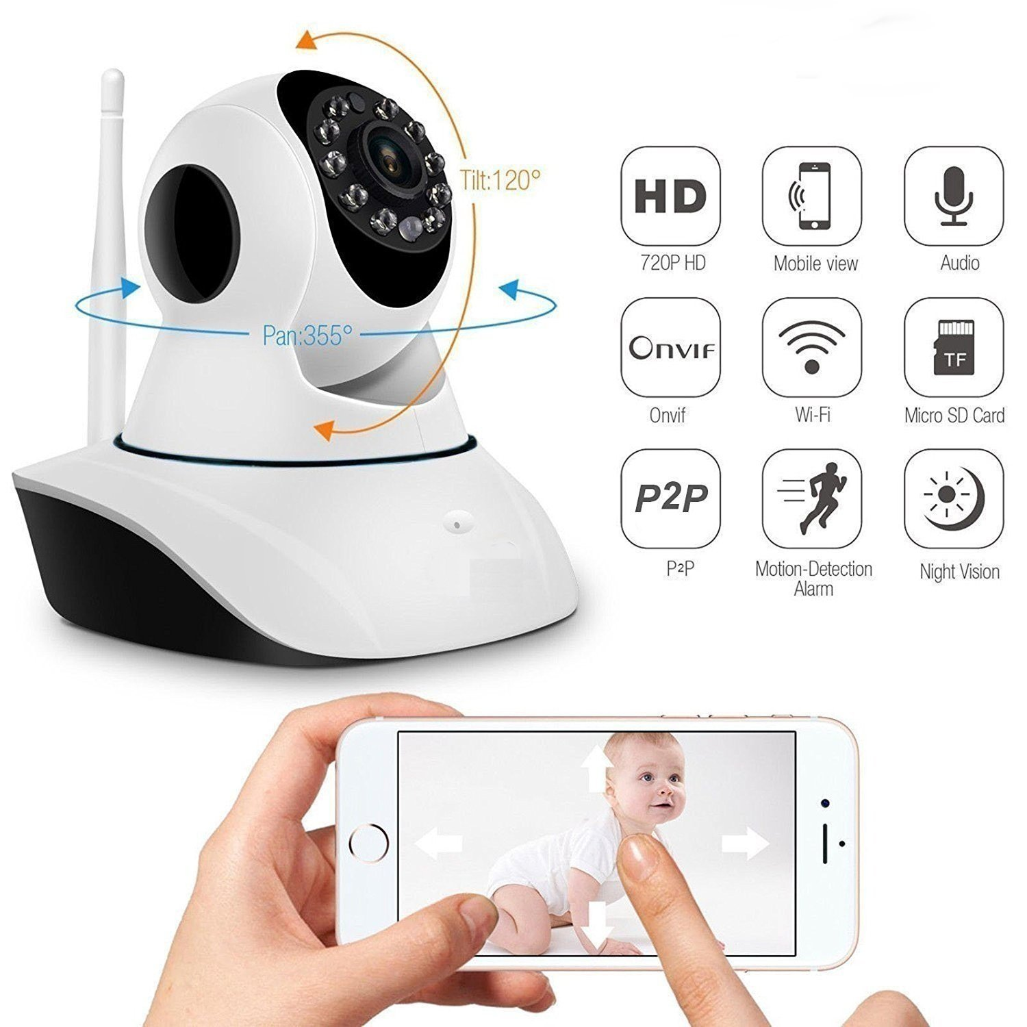
LIVE CAMERA

Slide 7
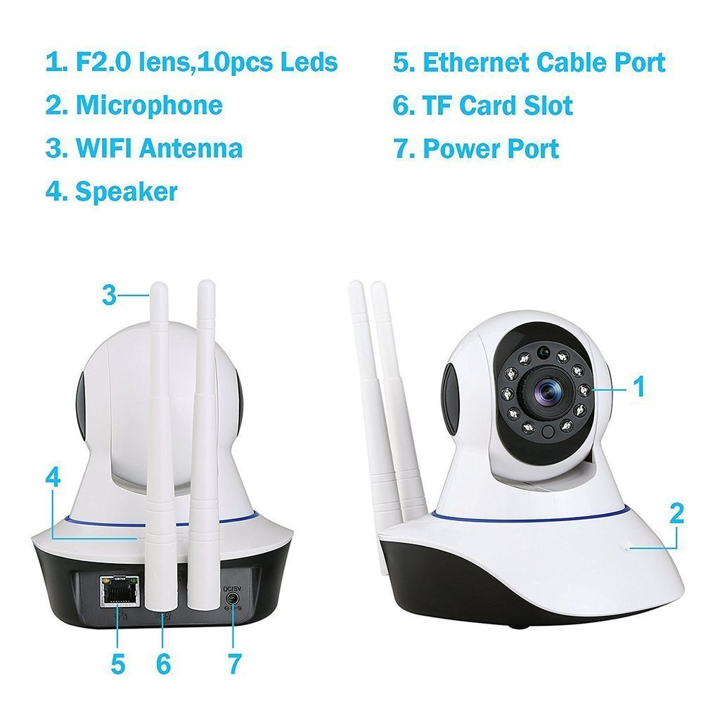
LIVE CAMERA

Slide 8
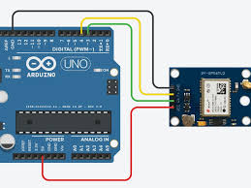
GPS WITH ARDUINO

Slide 9
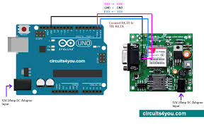
GSM WITH ARDUINO

Slide 10
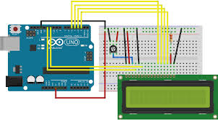
LCD WITH ARDUINO

Slide 11

GPS MODULE, SIM900 GSM AND LCD INTERFACING WITH ARDUINO

Slide 12
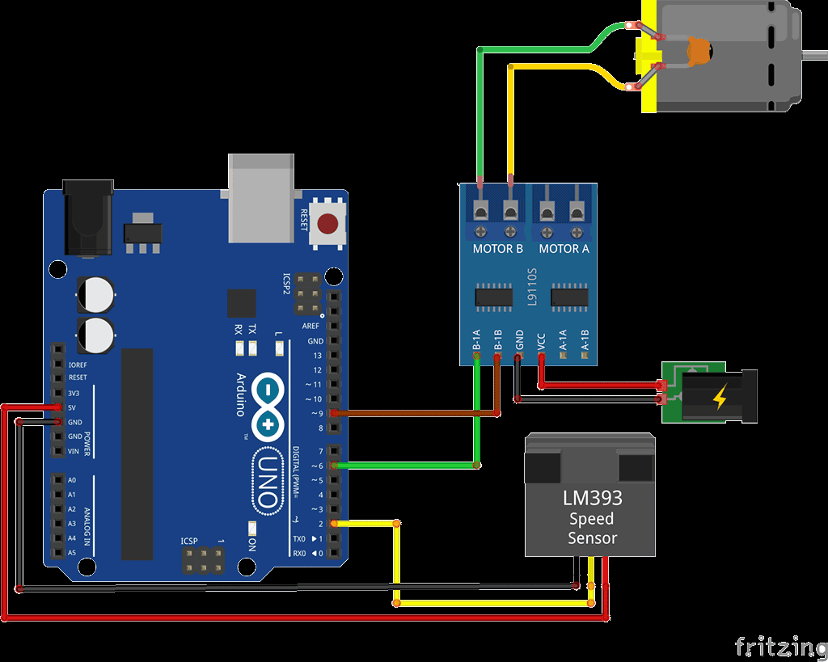
SPEED METER WITH ARDUINO

Slide 13
MESSAGE FORMATS
SEND Track Vehicle MESSAGE FROM YOUR MOBILE.
MESSAGE RECEIVED;
Vehicle Tracking Alert:
Your Vehicle current location is:
Latitude: *Latitude value*
Longitude: *Longitude Value*
USE NAME AND PASSWORD OF CAMERA: ***.***.***.***
LINK: click here for live location in google map
SPEED: SPEED OF VEHICLE

Slide 14
PROS AND CONS
INSTANTANEOUS LOCATION OF SCHOOL BUS WILL BE KNOWN.
SPEED OF VEHICLE WIIL BE KNOWN.
LIVE STREAMING OF VIDEO IS SUPPORTED.
LIVE TRACKING IS NO SUPORTED.

